Slide 1
Project Report of Basic Calculator

Slide 2
Project Title: Basic Calculator
Project Title: Basic Calculator
Submitted By: Mahadev Kurwade
Course/Subject: OPEN Elective
Submitted To: Wankhede Mam
Date: 29/09/2024

Slide 3
Table of Contents 2. Introduction 3. Objective 4. Scope 5. Features 6. System Requirements 7. Technologies Used 8. Design and Architecture 9. Implementation 10. Testing 11. Result and Output 12 Conclusion 13. Future Enhancements 14. References

Slide 4
Introduction
Overview: The Basic Calculator project is designed to perform arithmetic operations like addition, subtraction, multiplication, and division. It serves as a simple and user-friendly tool that helps users perform calculations quickly.
Purpose: To create a web-based calculator that follows the BODMAS rule and handles multiple consecutive operations correctly.
Audience: The project is intended for users who need a quick and accessible tool for performing basic arithmetic calculations

Slide 5
Objective
To develop a responsive, user-friendly calculator using HTML, CSS, and JavaScript.
To ensure the calculator follows the BODMAS rule for proper mathematical operations.
To create a dynamic user interface that enhances the user experience.
Scope
This project can be used as a learning tool for understanding how arithmetic operations are implemented in a web application.
It can be extended to include more advanced mathematical functions like square roots, exponents, trigonometric calculations, etc.

Slide 6
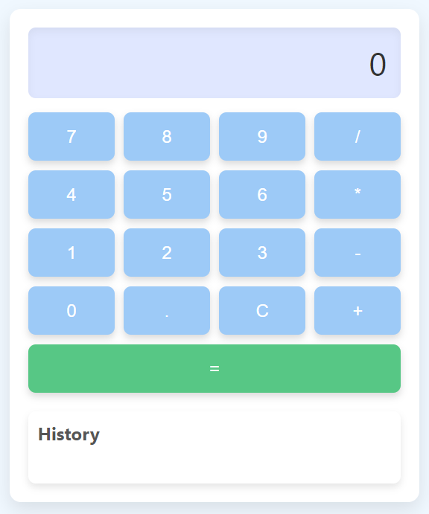
Features
6. Features
Basic Arithmetic Operations: Addition, Subtraction, Multiplication, and Division.
BODMAS Rule Implementation: Handles operator precedence to ensure accurate results.
Dynamic Display: Updates the display with user input and the current calculation.
Clear Function: Allows users to reset the display for a new calculation.
Undo Function: Enables users to undo the last input, providing better control over calculations.

Slide 7
System Requirements
Software:
Operating System: Windows/Linux/MacOS
Web Browser: Chrome, Firefox, Edge, or Safari
Code Editor: Visual Studio Code, Sublime Text, or any other preferred IDE
Hardware:
Processor: Intel Core i3 or higher or any working
RAM: 1 GB minimum
Hard Disk: 200 MB free space

Slide 8
Technologies Used
Technologies Used
HTML: Structure of the web page.
CSS: Styling for user interface elements.
JavaScript: Functionality for handling user input and performing calculations.

Slide 9
9. Design and Architecture
User Interface (UI): Description of the UI layout, including the calculator display, buttons for digits, operators, and the clear function.
Flow Diagram: A flow diagram showing the user interactions with the calculator and how the operations are processed.
Design Considerations:
Responsiveness: Ensuring the calculator works on various screen sizes.
Accessibility: Making sure that the calculator is easy to use for everyone, including those with disabilities.

Slide 10
Implementation
HTML Structure: Explanation of the HTML structure, including the buttons and display elements.
CSS Styling: Description of the CSS styles used for the layout, colors, and hover effects.
JavaScript Functions:
Function for handling input.
Function for performing calculations based on the BODMAS rule.
Function for clearing the display.
Function for handling the undo operation.
Code Snippets: Include key parts of the code for better understanding.

Slide 11
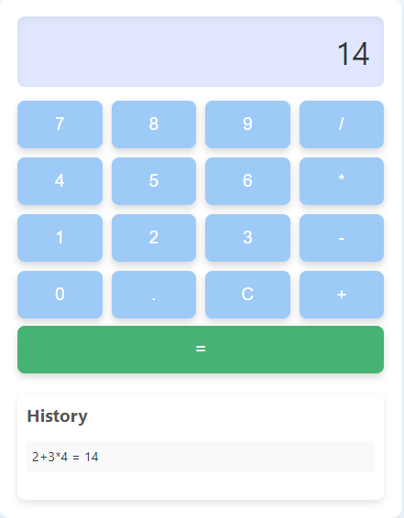
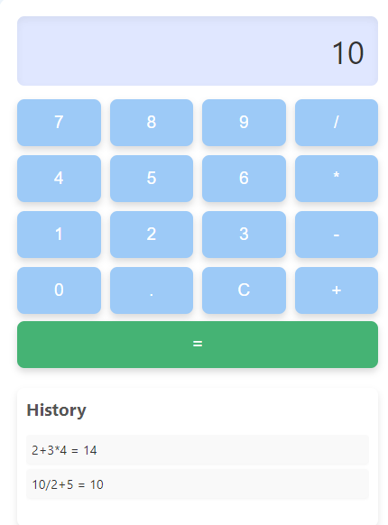
Testing
Testing Methodology: Describe how the calculator
was tested, including manual testing and any automated
testing methods.
Test Cases: Provide a few test cases like:
Input: 2 + 3 * 4 → Expected Output: 14
Input: 10 / 2 + 5 → Expected Output: 10
Result: Include the test results and any issues found during testing.

Slide 12
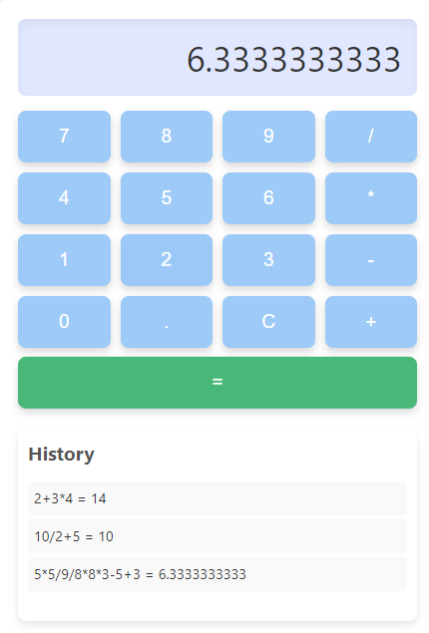
Result and Output
Screenshots: Include screenshots of the calculator interface, examples of calculations, and the results.
Performance: Describe how the calculator performs in terms of speed and accuracy.

Slide 13
Conclusion
Summarize the project and its achievements.
Mention how the project meets the objectives set out initially.
Discuss the learning outcomes from developing this project.

Slide 14
Future Enhancements
Adding support for advanced functions like square roots, percentages, and trigonometry.
Improving the user interface with animations and sound feedback.
Allowing users to customize the theme and layout of the calculator.

Slide 15
References
List all the references and resources used during the development of this project, such as tutorials, documentation, and guides.
Example:
JavaScript Documentation
CSS Flexbox Guide
HTML Forms Reference

Slide 16
Thank you
MAHADEV KURWADE
kurwademahadev@gmail.com

